Slide 1
Research Update
Control Barrier Function Augmentation in Sampling-based Control Algorithm for Sample Efficiency

Slide 2
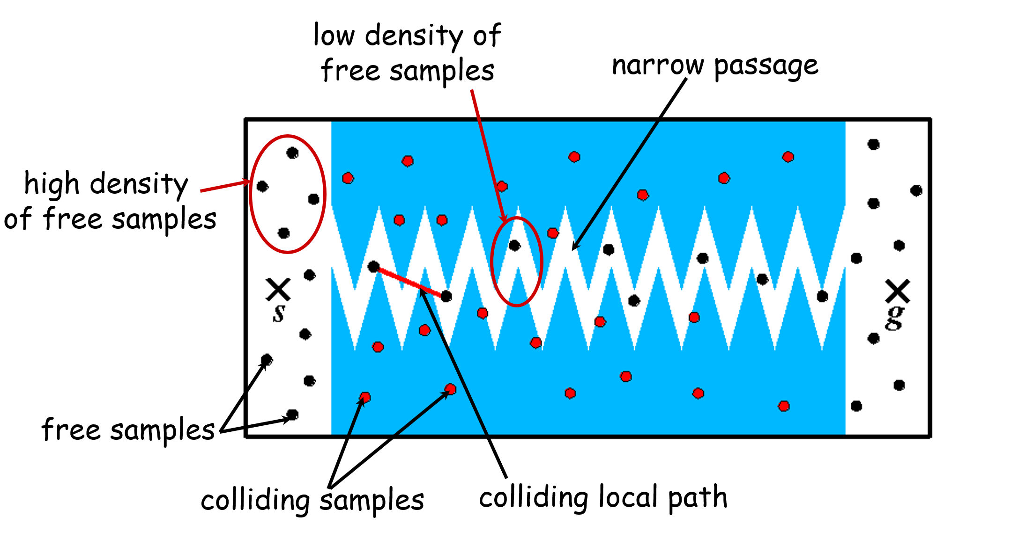
Motivation
Uniformly randomized sampling algorithms can become sample-inefficient in extreme circumstances, such as in a small region connecting two large free space areas, i.e., narrow passage problems.
It takes more time for sampling-based algorithms to identify a safe path passing through the narrow passage, though the portion of the narrow passage is small compared to the whole configuration space.
We aim to develop a MPPI-CBF algorithm that restricts the sampling distribution in the MPPI algorithm by using the control barrier function (CBF) to improve the sample efficiency of sampling-based algorithms for narrow passage problems.

Slide 3
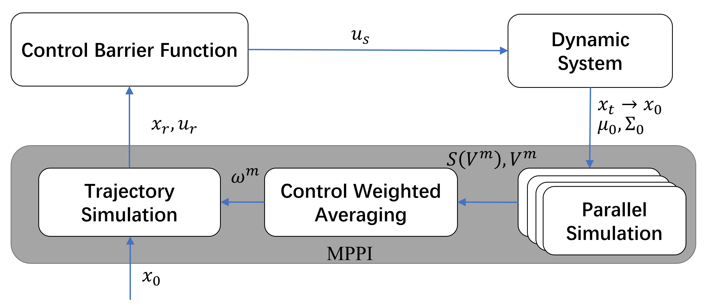
CBF-Based Compensating Control with MPPI
The MPPI algorithm provides the nominal control input and using the CBF-based optimization to find a minimum control intervention renders the safe set forward invariant.
Control architecture combining MPPI control with CBF to compensate for unsafe actions without considering the influence of CBF on the weights of the samples. The method guarantees safety but does not yield identical performance level to MPPI

Slide 4
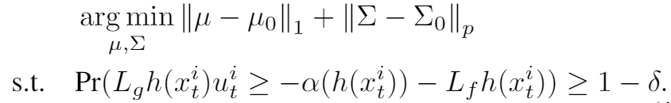
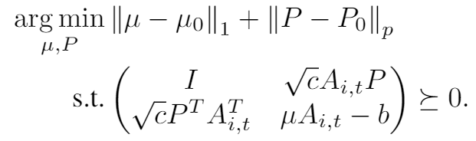


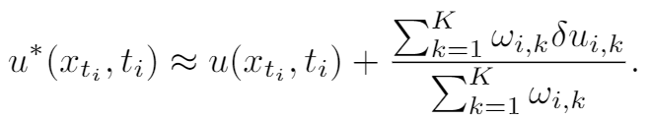
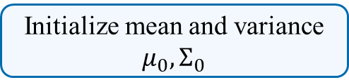

CBF-Based Trust Region Sample Control with MPPI
Probability CBF constraints
Initialize mean and variance $μ_{0},Σ_{0}$
Safe mean and variance $μ, Σ=P^{T}P$
Update safe mean and variance based on the SDP
Sampling trajectories
Randomly sampled control inputs
Sample trajectory evaluation
Trajectories weights update
Control input
Control update

Slide 5
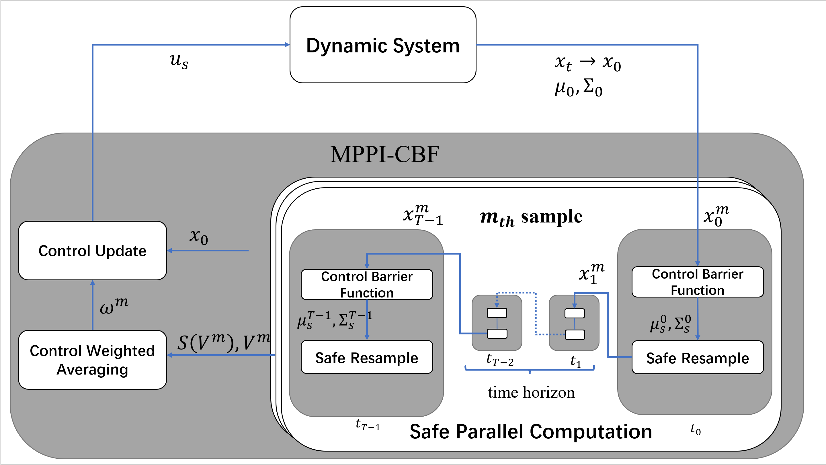
CBF-Based Trust Region Sample Control with MPPI
We solve the SDP optimization for each sample and at each time step to find a safe mean and variance and sample a new safe control input at current time step.
Next, we propagate through the dynamics of the robot and repeat at the next time step. Therefore, we can sample safe trajectories and calculate their weights for the control update law.
Finally, we update the control policy based on the weights.

Slide 6
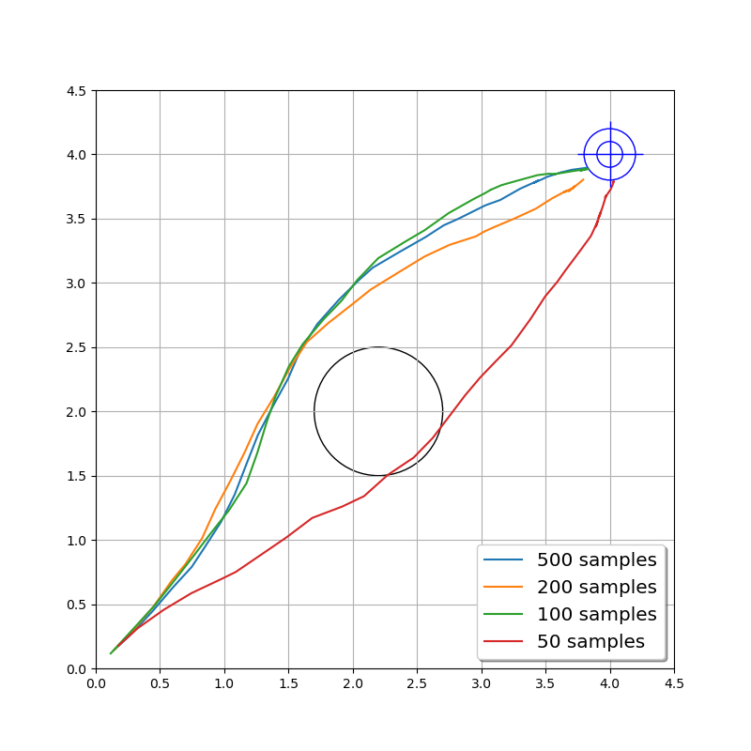
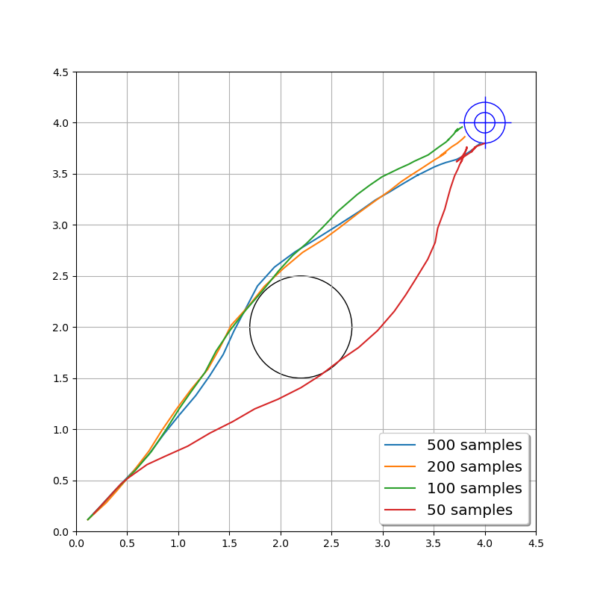
Simulation
We use 500, 200, 100, and 50 samples to test in the single-obstacle avoidance scenario.
Comparing to the MPPI-CBF algorithm, the trajectories from the MPPI algorithm are more aggressive, which can be explained as the MPPI algorithm samples uniformly in the configuration space, whereas the MPPI-CBF algorithm samples in a safe but more conservative space

Slide 7
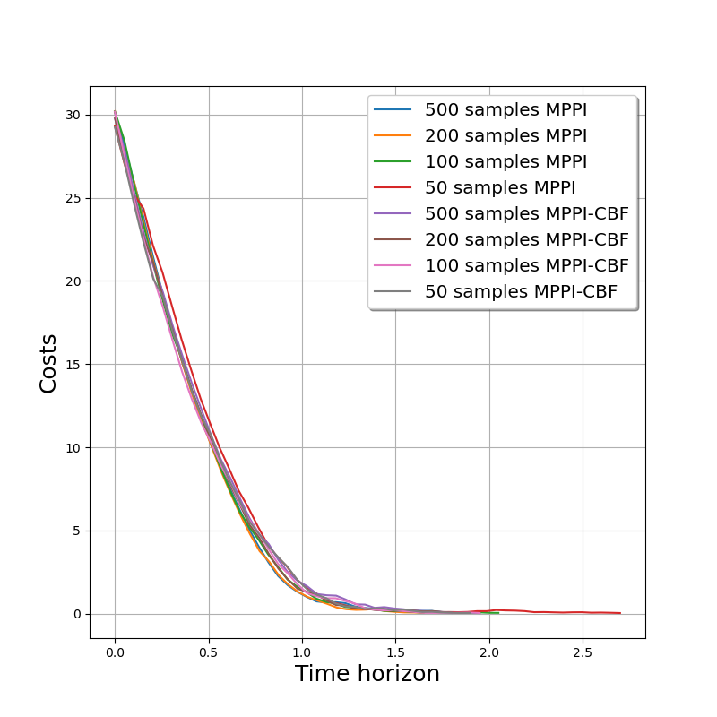
Simulation
The cost of the MPPI algorithm and the MPPI-CBF algorithm.
In the single-obstacle avoidance scenario, the MPPI and the MPPI-CBF algorithm spend almost the same time steps to solve the path planning problems.

Slide 8
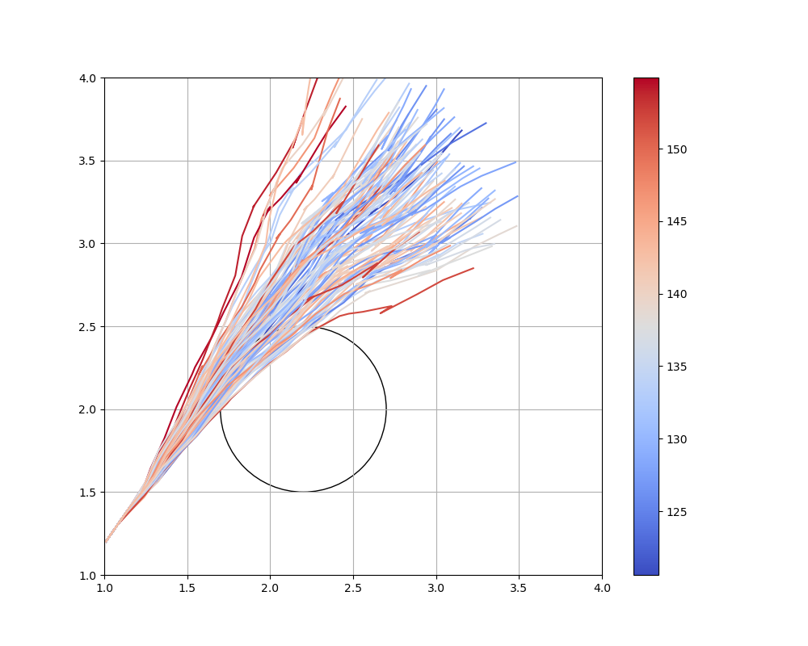
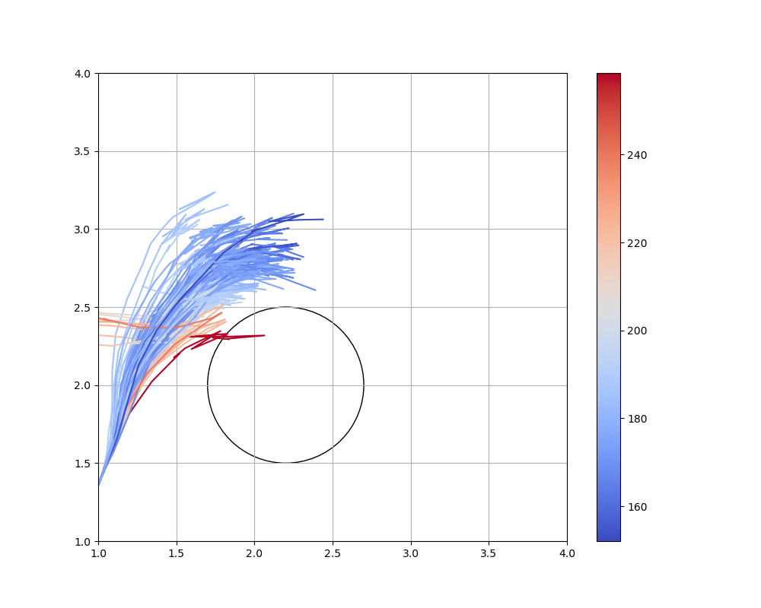
Simulation
The first figure shows the MPPI algorithm sample uniformly in the configuration space.
The second figure shows the MPPI-CBF algorithm sample in a restricted safe space.

Slide 9
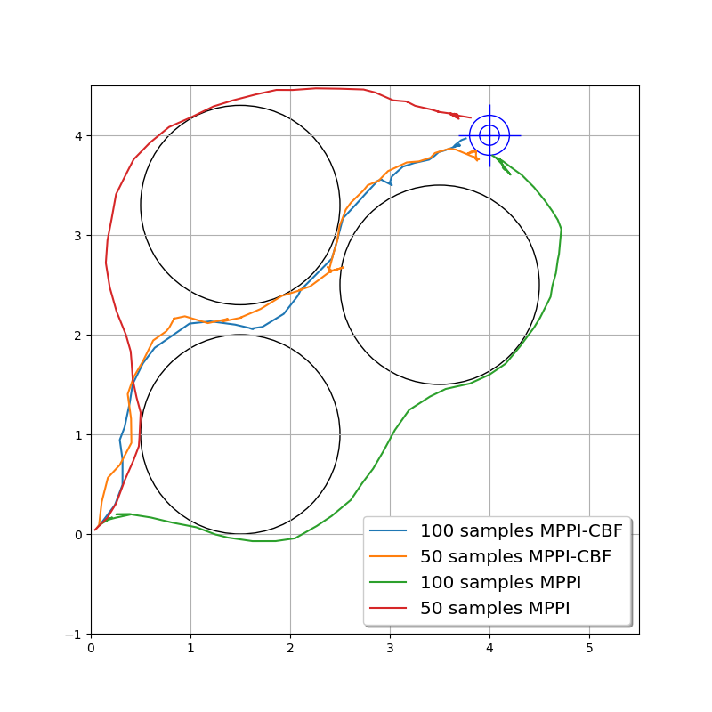
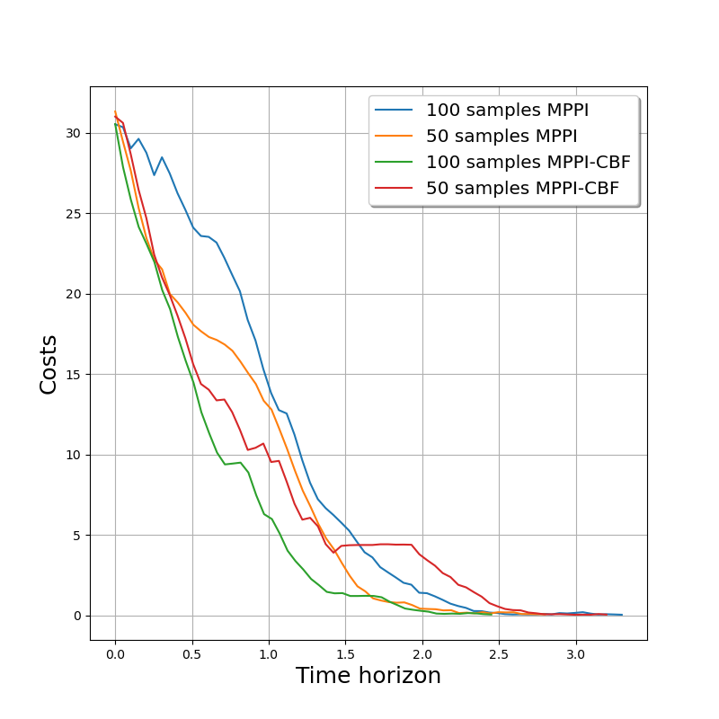
Simulation
We plot the trajectories from the MPPI and the MPPI-CBF algorithms, with sample numbers of 50 and100.
In the multi-obstacle narrow passage simulation, the MPPI algorithm takes more time steps to solve the problem than the MPPI-CBF algorithm due to the higher sample efficiency of the latter approach.

Slide 10
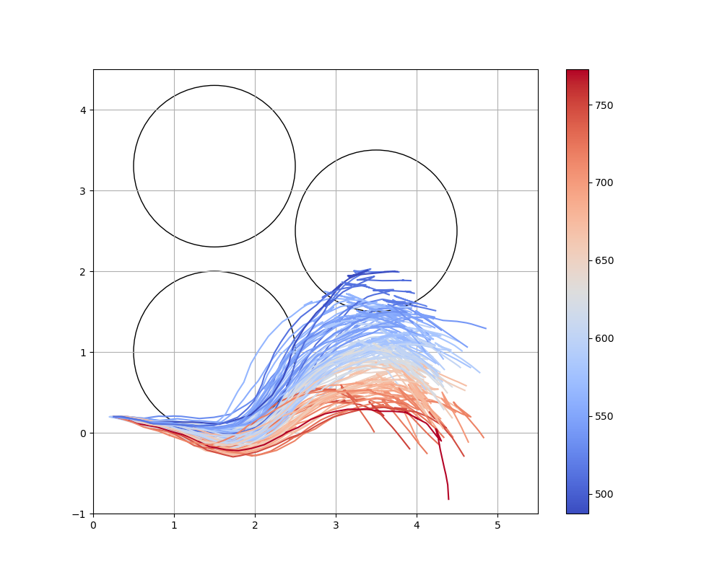
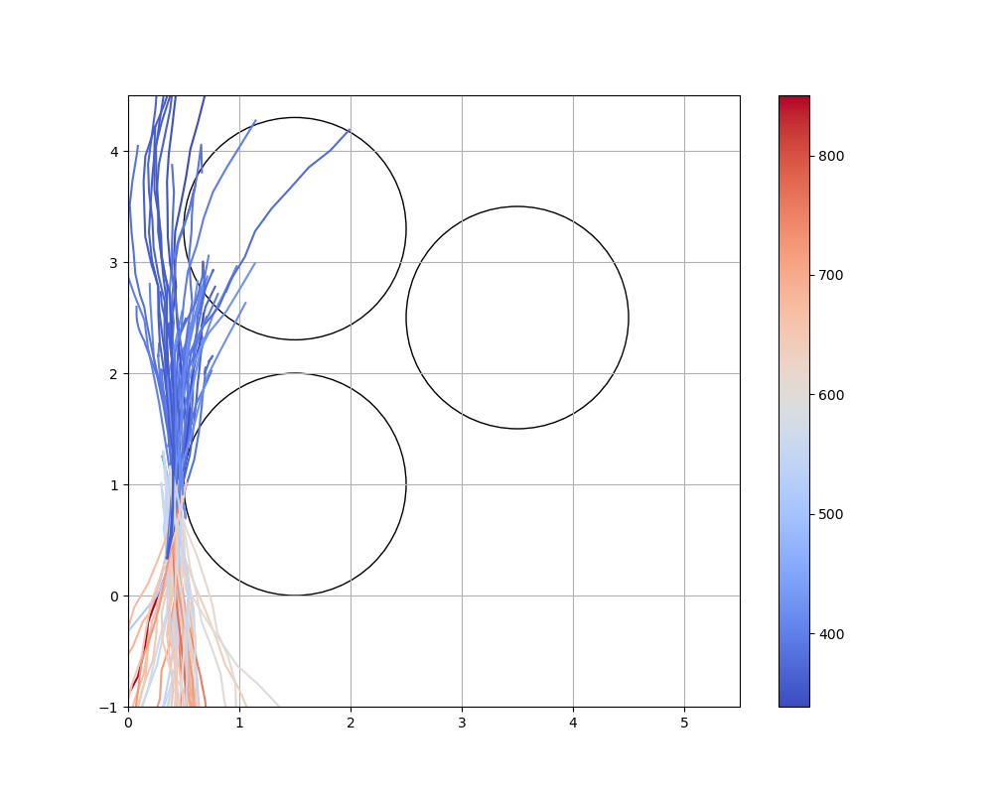
Simulation
The first figure shows that the MPPI algorithm samples uniformly in the configuration space.
The second figure shows that the MPPI-CBF algorithm samples from a restricted safe space.

Slide 11
Conclusions
We present an MPPI-CBF algorithm that uses the control barrier function to increase the safe efficiency and guarantee the safety of the sampling-based MPPI algorithm.
We demonstrate that our algorithm can guarantee safety in cluttered environments, and our method can sample more efficiently.
The future work considers accelerating the algorithm by solving the SDP problem more efficiently and pursuing theoretical analysis on how the newly added state-dependent variance in the proposed algorithm deviates from the existing MPPI algorithm in terms of optimality

Slide 12







Control Barrier Function
Dynamic System
$$u_{s}$$
$$x_{t}→x_{0}$$
$$x_{r},u_{r}$$
$$μ_{0},Σ_{0}$$
MMPPi
Trajectory Simulation
$$ω^{m}$$
Control Weighted Averaging
$$S\left(V^{m}\right),V^{m}$$
Parallel Simulation
Parallel Simulation
Parallel Simulation
Parallel Simulation
MPPI
$$x_{0}$$

Slide 13
















Dynamic System
$$u_{s}$$
$$x_{t}→x_{0}$$
$$μ_{0},Σ_{0}$$
MPPI-CBF
Safe Parallel Computation
Safe Parallel Computation
Safe Parallel Computation
$$x_{T−1}^{m}$$
$m_{th}$ sample
$$x_{0}^{m}$$
Control Update
$$x_{0}$$
Control Barrier Function
$$x_{0}^{m}$$
Control Barrier Function
$$ω^{m}$$
$$μ_{s}^{T−1},Σ_{s}^{T−1}$$
$$μ_{s}^{0},Σ_{s}^{0}$$
Control Weighted Averaging
$$S\left(V^{m}\right),V^{m}$$
Safe Resample
$$t_{T−2}$$
$$t_{1}$$
Safe Resample
time horizon
$$t_{T−1}$$
$$t_{0}$$

